Slide 1
What is Node.JS?

Slide 2

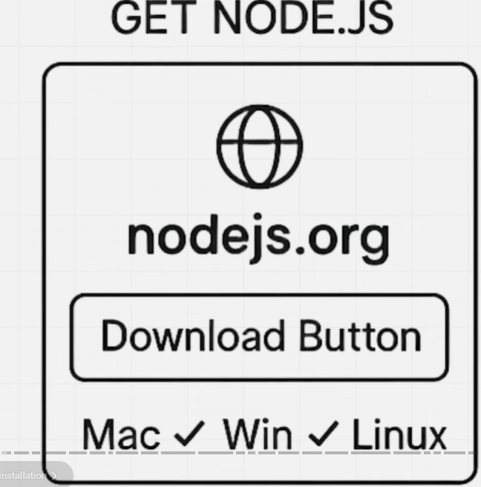
Prerequisite
Node.js is a cross-platform, open-source JavaScript runtime environment that allows you to execute JavaScript code on the server side, outside of a web browser
Originally created by Ryan Dahl in 2009, it is built on Google Chrome's V8 JavaScript engine, which compiles JavaScript directly into native machine code for extremely fast execution

Slide 3
Core Architecture of Node.js: How It Works
Unlike traditional web servers that create a new "thread" (a separate process) for every single user request, Node.js uses a Single-Threaded Event Loop mode
Non-Blocking I/O: When Node.js performs a task like reading a file or querying a database, it doesn't wait for the task to finish. Instead, it offloads that task to the system and moves on to the next request immediately.
The Event Loop: This is the "brain" of Node.js. It continuously monitors a queue of completed tasks and triggers "callbacks" (responses) once the data is ready.
Efficiency: This architecture allows a single Node.js server to handle thousands of concurrent connections simultaneously with very low memory usage.

Slide 4
Key Features of Node.js
Unified Language: You can use JavaScript for both the frontend (browser) and the backend (server), which simplifies development and code sharing.
Vast Ecosystem (NPM): Node comes with NPM (Node Package Manager), the world's largest registry of open-source libraries, allowing you to easily add pre-built features to your app
System Access: Unlike browser JavaScript, Node.js can directly access your computer's file system, manage network connections, and interact with operating system hardware.
Native TypeScript Support: From version 22.6.0 onwards, Node.js can execute TypeScript files directly without needing a separate compilation step

Slide 5
Common Use Case
Node.js is the preferred choice for applications that require high performance and real-time updates:
Real-Time Apps: Chat applications (like WhatsApp), online gaming, and collaboration tools (like Google Docs).
Streaming Services: Platforms like Netflix use Node.js to handle massive data streams efficiently.
APIs and Microservices: It is ideal for building fast RESTful or GraphQL APIs that power modern mobile and web apps.
IoT (Internet of Things): Its low resource usage makes it perfect for managing data from thousands of connected sensors

Slide 6
Browser JavaScript vs. Node.js
Feature | Browser JavaScript | Node.js
Global Object | window | global
DOM Access | Yes (can change HTML/CSS) | No (runs in a terminal)
File System¹⁶ | No (for security reasons)¹⁷ | Yes (full read/write access)¹⁸
API Support | Fetch, Geolocation, Canvas | FS, Path, HTTP, OS

